Slide 1
TSDSI Observations

Slide 2
Contents
TSDSI pi/2-BPSK and 3GPP pi/2-BPSK
Results in section 20 of the self-evaluation
The 5th percentile user spectral efficiency results from TCOE

Slide 3
TSDSI pi/2-BPSK and
3GPP pi/2-BPSK

Slide 4
TSDSI pi/2-BPSK and 3GPP pi/2-BPSK
Spectrum shaping improves PAPR but degrades receiver performance
The extent to which the PAPR improvement can be used to increase power depends on UE implementation and regulations
Both 3GPP and TSDSI RITs support pi/2-BPSK with spectrum shaping
  For 3GPP the filter is not specified and unknown by the receiver
  For TSDSI the filter is specified and known by the receiver
Why is the TSDSI RIT not compared to the 3GPP RIT with pi/2-BPSK and spectrum shaping?

Slide 5
Results in section 20 of the self-evaluation

Slide 6
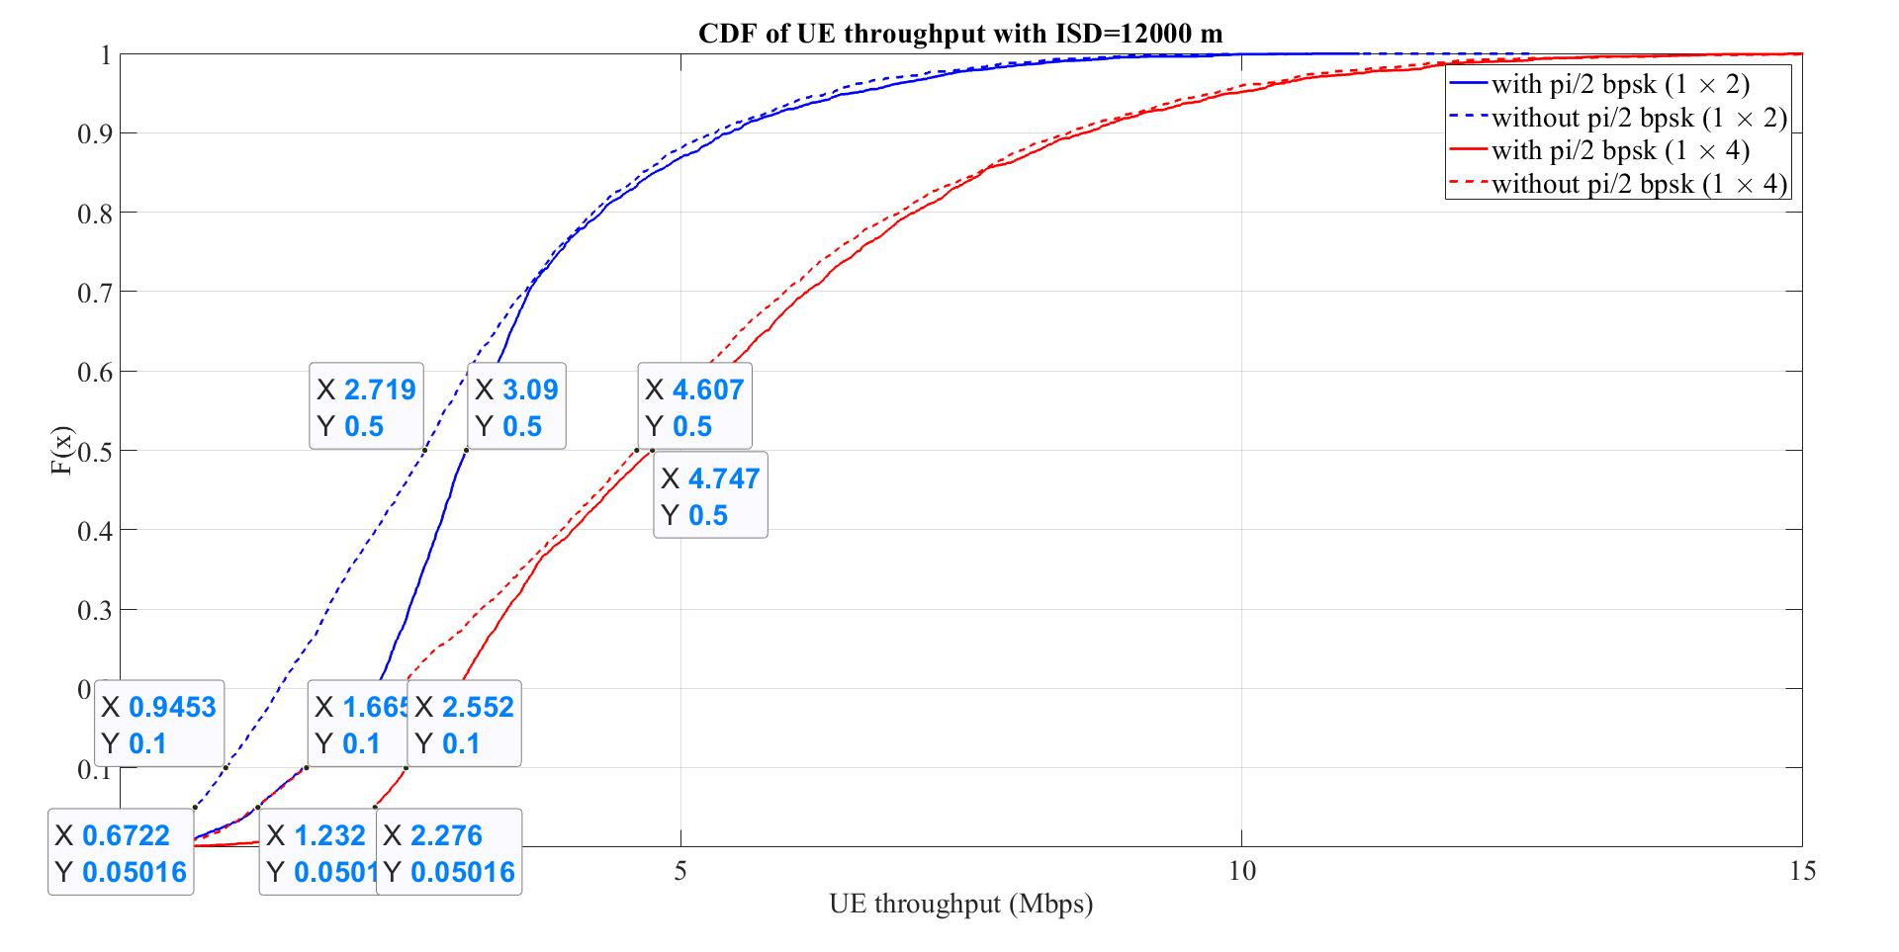
Section 20 of the TSDSI self-evaluation
Submission: https://www.itu.int/md/R15-WP5D-C-1301/en, self-evaluation in Appendix 5
Section 20 contains additional results for
  LMLC scenario with 12km ISD
  60MHz TDD at 3.5GHz
  10 UEs per sector, FDM scheduling
  2 or 4 BS antennas
  UE power
    23dBm with QPSK
    26dBm with pi/2-BPSK
Results indicate 0.67 – 2.3Mbps at 5th
percentile

Slide 7
Is it reasonable?
For LMLC with 6km ISD and 700MHz, the coupling gain at the 5th percentile is -130.4dB
With a frequency dependency of 20*log10(f), we get an additional loss at 3.5GHz of 20*log10(3.5/0.7) = 14dB
With a distance dependency of 38.6*log10(d), we get an additional loss for 12km ISD of 38.6*log10(12/6)= 11.6dB
The resulting coupling gain is -156dB
The received power is 26dBm – 156dB = -130dBm
The noise power on 6MHz is -101dBm
  10*log10(4e-21*6e6/1e-3)+5
The SNR per antenna (no interference) is -29dB
With 4 branch diversity the SNR is -23dB = 0.005
The data rate is W*log2(1+SNR) = 6e6*log2(1+0.005) = 43kbps
This is much lower than reported by TSDSI

Slide 8
Cell average and 5th percentile user spectral efficiency

Slide 9
Summary
The average spectral efficiency and 5th percentile user spectral efficiency results for TSDSI from TCOE differ by less than a factor 10
This should not be mathematically possible - a clarification is needed
5th percentile user spectral efficiency results appear very high, whereas the average spectral efficiency results are more similar to others
Possibly the 5th percentile user spectral efficiency were calculated in a way different from the IMT-2020 guidelines?

Slide 10
Cell average and 5th percentile user spectral efficiency
From M.2410, we note that the 5th percentile user spectral efficiency is the 5th percentile of the normalized user throughput. Inserting the formula for normalized user throughput into the expression for average cell spectral efficiency, results in that the average cell spectral efficiency can be expressed as the average normalized user throughput multiplied by the average number of users in the system (N) divided by the number of TRxPs (M). The average of a distribution (of non-negative numbers) is at least 0.95x its 5th percentile. This means that cell average SE >= N/M * 0.95 * 5th percentile user SE. With N/M = 10 we get cell average SE >= 9.5 * 5th percentile user SE

Slide 11
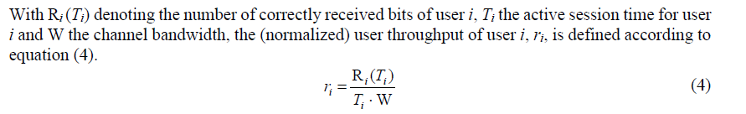
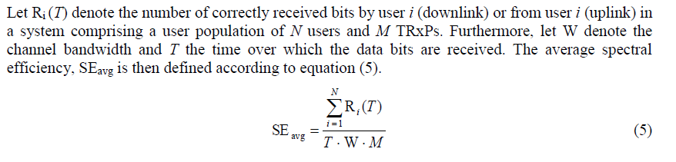
Maths
Note that for full buffer traffic Ti=T
5th percentile user spectral
efficiency= percentile(r_i, 5)
Cell average spectral efficiency
SEavg = sum(R_i)*N/(N*T*W*M) = avg(R_i)*N/M/W = avg(r_i) * N/M = {N/M = number of users per cell = 10} = avg(r_i) * 10
Ratio = 5th perc user SE / SE avg = percentile(r_i, 5) / (avg(r_i) * 10) = {avg >= 0.95*5th perc} <= 1/9.5

Slide 12
Example
10 users in a cell
All have a data rate of 10Mbps when scheduled
Assume RR, TDM or FDM scheduling
  Cell average spectral efficiency = 10Mbps / 10MHz = 1bps/Hz
  User throughput = 10Mbps/10users = 1Mbps
  5th percentile user spectral efficiency = 1Mbps/10MHz = 0.1bps/Hz (one tenth of cell SE)
With ideal MU-MIMO
  Cell average spectral efficiency = 10 * 10Mbps / 10MHz = 10bps/Hz
  User throughput = 10Mbps/1 = 10Mbps
  5th percentile user spectral efficiency = 10Mbps/10MHz = 1bps/Hz (one tenth of cell SE)

Slide 13
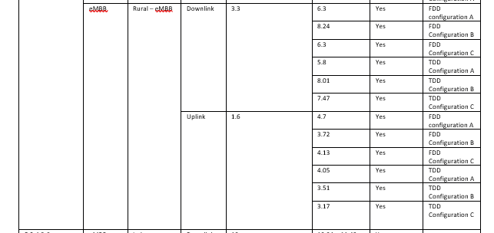
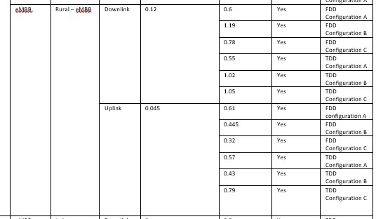
Doc 30, TCOE
Avg
5th percentile

