Slide 1
EUHT technology analysis version 2
2021/01

Slide 2
IMT-2020 minimum technical performance requirements
3 usage scenarios 5 test environment min. technical requirements
eMBB
mMTC
URLLC
Indoor Hotspot-eMBB
Dense Urban-eMBB
Rural-eMBB
Urban Macro–mMTC
Urban Macro–URLLC
Peak data rate
Peak spectrum efficiency
User experience data rate
5th percentile user spectral efficiency
Average spectral efficiency
Area traffic capacity
Latency
Connection density
Energy efficiency
Reliability
Mobility
Mobility interruption time
Bandwidth
(Document IMT-2020/2)
Step 6 – Review to assess compliance with minimum requirements
… In this step, the evaluated proposal for an RIT/SRIT is assessed as a qualifying RIT/SRIT, if an RIT/SRIT fulfils the minimum requirements for the five test environments comprising the three usage scenarios….

Slide 3
Related documents
Document number | Meeting | Content | Source
IMT-2020/18 rev1 (5D/1300) | WP5D #32, June 2019 | The submission from EUHT proponent in Step 3, including Description template link budget self-evaluation report technology spec | Nufront
IMT-2020/35 rev1 | WP5D #34, Feb 2020 | Bnrist evaluation report | Bnrist
5D/188 | WP5D #35, June 2020 | New technology spec DIS | Nufront

Slide 4
Analysis of EUHT’s working modes

Slide 5
EUHT’s working modes
(from Doc 5D-222 Att. 5.4) “The generation procedure of each subchannel is described in 8.2 and can be classified into three working mode: normal mode, low-error mode and mmWave mode.”
Low-error mode is dedicated to URLLC scenario, while eMBB is covered by normal mode (configurations used in self evaluations 5D/1300)
 |  | Normal mode | Low-error mode
SICH |  | BPSK 1/2, No repetition | integrated into CCH
CCH |  | QPSK 4/7, No repetition | Support frequency and time domain rep
TCH | Modulation | BPSK, QPSK, 16QAM, 64QAM, 256QAM, 1024QAM | QPSK
 | Coderate | 1/2, 3/4, 5/8, 5/6, 7/8 | 1/2, 4/7
 | Code length (Codeword) | 448, 1344, 2688, 5376 | 448
 | Repetition | No repetition | Support frequency and time domain rep
MIMO | MU-MIMO | Support up to 8 layers | Not support
 | Stream number (layer) | 1~8 | 1
 | Codeword number | 2 | 1

Slide 6

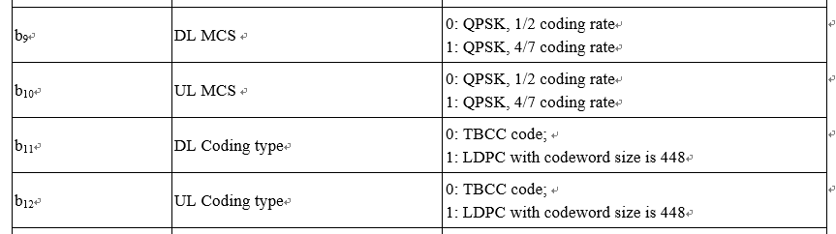
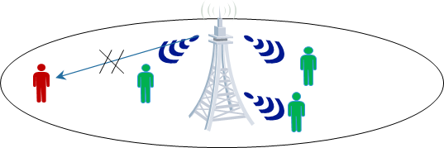
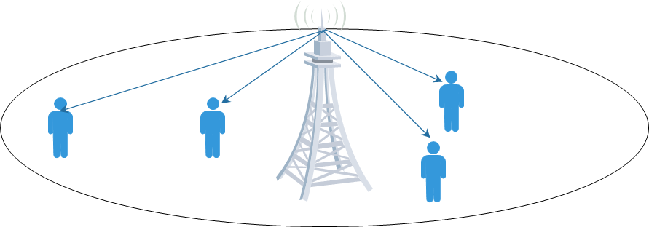
Neither normal or low-error mode is good for eMBB
The operation point of normal mode is too high, leading to low reliability for low geometry users, especially for Dense Urban and Rural scenarios
On the other side, the spectral efficiency of low-error mode is too low for eMBB, because of no-MIMO, few MCS options (only QPSK), small codeword size (only 448 in low-error mode) etc.
Normal mode
Low-error mode
Low reliability
Low spectral efficiency

Slide 7
Normal mode is not qualified for eMBB
step1
step2
step3
step4
Next available frame
TCH
Preamble detection:
low error mode or normal mode
SICH: system information
CCH: scheduling information
MAC BCF frame reception:
low error or normal mode content
Data transmission
Link budget: Control channels use fixed and high coding rate, can not support the operation in low SNR e.g. cell edge, large cell
  SICH: BPSK 1/2, No repetition
  CCH: QPSK 4/7, No repetition
Related KPI
Peak data rate
Peak spectrum efficiency
User experience data rate
5th percentile user spectral efficiency
Average spectral efficiency
Area traffic capacity
Latency
Connection density
Energy efficiency
Reliability
Mobility
Mobility interruption time
Bandwidth
Together with many other problematic designs, EUHT can not meet ITU spectrum efficiency requirements in multi-user and multi-cell environment
  No HARQ
  Sparse MCS
  High system overhead (high CP time domain overhead, many unavailable frequency resources for data subcarrier….)
  Limited MIMO layers (up to 8)
  …

Slide 8
Low-Error mode: unclear procedure for URLLC
(from Doc 5D-222 Att. 5.4)“In low-error mode, the function of system information channel is integrated into the control channel to reduce the overhead.”
Many important information of SICH are not integrated into CCH of low-error mode, the system does not work without these information.
  CAP working bandwidth set
  CAP working bandwidth
  SCS
  …
(see the details in next pages)
Related KPI
Peak data rate
Peak spectrum efficiency
User experience data rate
5th percentile user spectral efficiency
Average spectral efficiency
Area traffic capacity
Latency
Connection density
Energy efficiency
Reliability
Mobility
Mobility interruption time
Bandwidth

Slide 9
Procedure issue of low-error mode
Normal mode
step1
step2
step3
step4
Preamble:
detects working mode
SICH:
Indicates SCS and CAP working bandwidth set
e.g. 011 for 20/40/80
CCH:
Indicates scheduling information: the effective subchannel position
TCH:
MAC BCF frame confirms working bandwidth. e.g. working bandwidth 1 is 20.
Low-error mode
X
step1
step2
step3
step4
Preamble detection:
detects working mode
No standalone SICH
CCH+SICH:
No information about SCS， CAP working bandwidth set，and the effective subchannel position.
TCH
When there is no information of SCS and working bandwidth of TCH, the STA cannot receive the BCF and data!
8.3 Preamble sequence

Slide 10
SICH: 112 bits (Table 55 normal mode)
CCH: 56 bits (Table 57 low-error mode)
bit | definition
b0-7 | The lowest 8 bits of CAP’s MAC ID
b8-10 | CAP working bandwidth set | e.g. 011 for 20/40/80
b11-12 | SCS | 10 for 78.125KHz
b13-19 |  | Reserved
b20 | CP for CCH and TCH | Normal/short
b21-23 | CP antenna number | 1-8
b24-b29 | CCH length | - 63
b30 | DRS model in MU-MIMO | DRS for STAs in same/diff symbol
b31 | Interleaving in LDPC | Bit interleaving or not
b32-42 | DL TCH length
b43-45 |  | Reserved
b46-56 | UL TCH length
b57-b63 | DGI/UGI configuration
b64 | W or w/o DL sounding
b65-66 | DIS: b65 DRS pattern (w or w/o offset) | Reserved
b67 | W or w/o UL sounding
b68 | DIS: indication of full-bandwidth or OFDMA scheme | Reserved
b69-70 | Length of UL scheduling request channel | 0,1,2,4 symbols
b71 | w or w/o UL random access channel
b72 | RACH or ranging
b73-75 |  | reserved
b76-87 | Frame number
b88-103 | CRC
b104-b111 | Return convolutional code state to zero
Bit | definition
b0-3 | The lowest 4 bits of this CAP MAC address
b4-5 | Frame length
b6-8 | DL ratio : UL ratio
b9 | DL MCS
b10 | UL MCS
b11 | DL Coding type
b12 | UL Coding type
b13-14 | DL Repetition number in frequency domain(N)
b15-16 | DL Repetition number in time domain(M)
b17-18 | UL Repetition number in frequency domain(N)
b19-20 | UL Repetition number in time domain(M)
b21-26 | Frame number
b27-28 | Uplink scheduling request channel
b29 | Uplink random access channel configuration
b30 | Indication of RACH and ranging
b31 | Indication of OFDMA scheme
b32-55 | 24-bit CRC

Slide 11
Switching between normal and low-error mode
Related KPI
(from Doc 5D-222 Att. 5.4) “Frame structure is described in 8.1.1, the normal mode and low-error mode can be distinguished by preamble sequence detection.”
  Assumed that when dynamic switching, all users have to detect preamble in each frame. It is harmful to URLLC, since the data reliability is decreased by low preamble detection probability.
  Whether dynamic switching or not, neither normal or low-error mode is good to eMBB in Page 6 .
Peak data rate
Peak spectrum efficiency
User experience data rate
5th percentile user spectral efficiency
Average spectral efficiency
Area traffic capacity
Latency
Connection density
Energy efficiency
Reliability
Mobility
Mobility interruption time
Bandwidth
Normal mode
Low-error mode
Low reliability
Low spectral efficiency

Slide 12
Further analysis

Slide 13
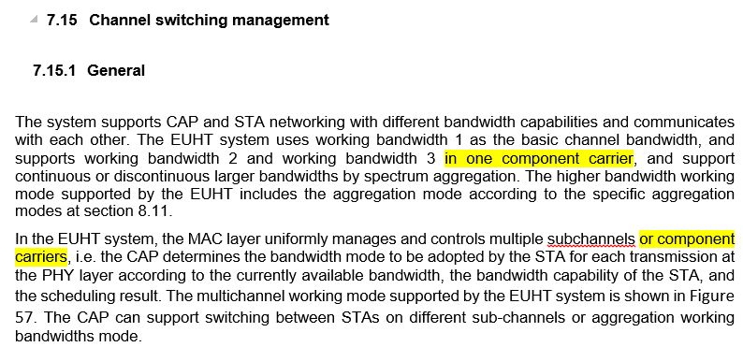
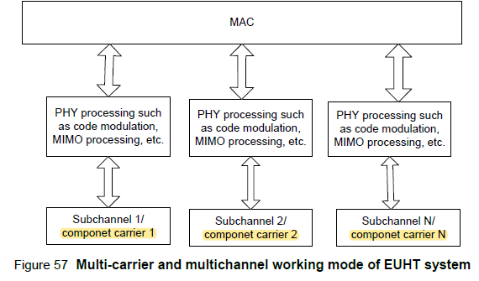
Premature specs cannot justify key functions (CA)
Lack of details to support carrier aggregation: the below sentences and figure are almost all information which was provided in the specs. They are “stage2” description on “what”, lack of “stage 3” details on “How”.
(From 5D/188, yellow highlight parts are modifications compared with IMT-2020/18 rev1)
Related KPI
Peak data rate
Peak spectrum efficiency
User experience data rate
5th percentile user spectral efficiency
Average spectral efficiency
Area traffic capacity
Latency
Connection density
Energy efficiency
Reliability
Mobility
Mobility interruption time
Bandwidth

Slide 14
Premature specs cannot justify key functions (HO interruption)
Lack of details to support 0ms mobility interruption time: the below flowchart is all information in the specs. There is not detailed definition about any involved signaling and CN entity
      7.19.2.3 Lossless Handover
(From EUHT specification)
Related KPI
Peak data rate
Peak spectrum efficiency
User experience data rate
5th percentile user spectral efficiency
Average spectral efficiency
Area traffic capacity
Latency
Connection density
Energy efficiency
Reliability
Mobility
Mobility interruption time
Bandwidth

Slide 15
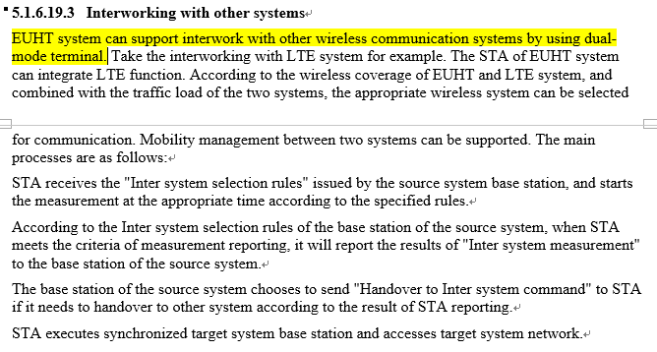
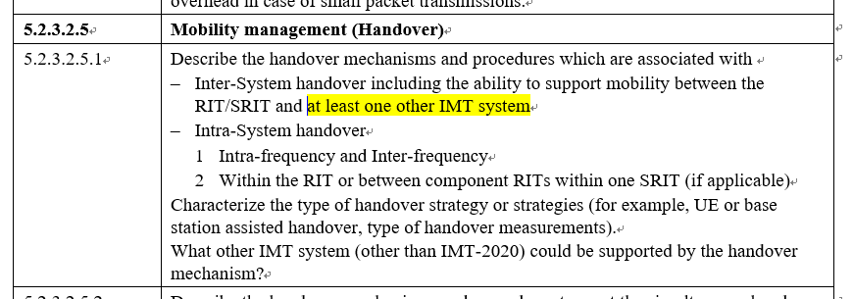
Premature specs cannot justify key functions (Intersystem HO)
According to “RIT/SRIT description template ” in M.2411, the technology shall support intersystem handover with at least one other IMT system.
the only answer from EUHT specs is “by using dual-mode terminal”, there is not any clue about the signaling and mechanism of intersystem measurement, handover etc.
from Doc 5D-222 Att. 5.4
From M.2411

Slide 16
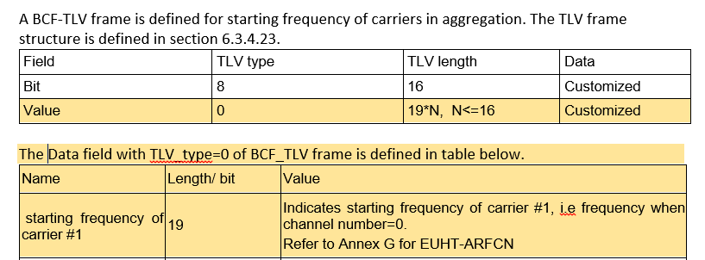
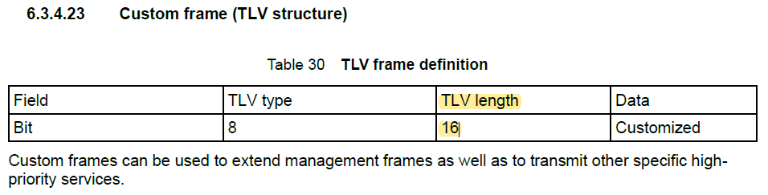
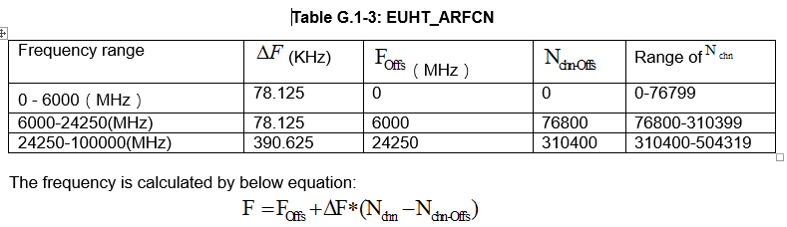
Premature specs cannot justify key functions (spectrum aspects)
Channel numbering is a key feature for spectrum aspects and the capability of CA
As pointed out by CEG in WP5D#35, 2020.2 : One important element that is missing is a channel numbering scheme and a frequency raster that would cover all the claimed frequency ranges. It is therefore difficult for the CEG to unequivocally conclude that the spectrum requirements are met.
In WP5D#36, 2020.6, new data fields, new table and new formulation were added, the specification can be revised very flexibly
5D/188 @ 36#5D in June 2020 (DIS)
EUHT specification in IMT-2020/18 rev1 (Step 3)

Slide 17
Others issues(inconsistent simulation methodology with ITU-R M.2412)
E.g. using different parameters in Mobility and Spectral efficiency as attached

Slide 18
Few use case can be supported by EUHT in low-error mode
(from Doc 5D-222 Att. 5.4) “Control channel field is described in 8.4.2 and Low density parity encoding is described in 8.2.3.3.2”
  “LDPC with codeword size is 448, QPSK, 1/2 or 4/7 coding rate” in Table 57 Control field definition in low-error mode in 8.4.2 .
  The information bits in EUHT are limited to 224 or 256 bits, when the repetition is indicated to achieve high reliability. However, many URLLC use cases need more message size to transmit. On the opposite, 3GPP can transmit large payload while the high reliability can be guaranteed.
 | Value
LDPC variable information bit K | 256 bits | 224 bits
code word size, Coding rate | 448, 4/7 | 448, 1/2
Modulation | QPSK
Required Subcarriers | 224
Valid data subcarriers in 20M bandwidth (78.125kHz) | 224

Slide 19
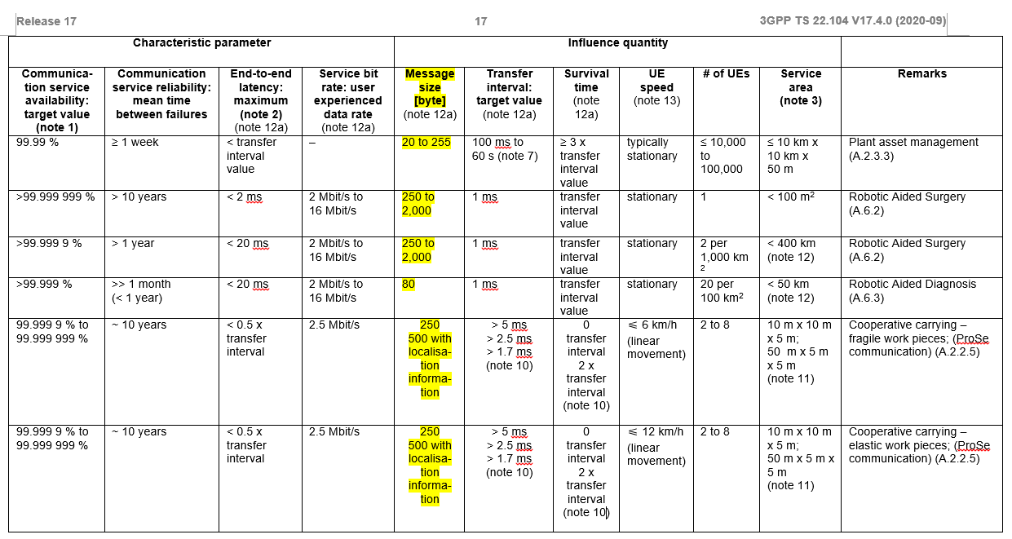
3GPP TS 22.104 v17.4.0 (2020-09)

Slide 20
Thank you

