Slide 1
DECT technology analysis
(Version 1)
2021/01

Slide 2
Initial analysis on DECT

Slide 3
Related documents
Document number | Meeting | Content | Source
IMT-2020/19 rev1 (5D/1299) | WP5D #32, June 2019 | The submission from EUHT proponent in Step 3, including Description template link budget self-evaluation report technology spec | DECT
Documents 5D/156, 157, 158 | WP5D #35, June 2020 | evaluation document | Sennheiser
WP 5D IMT-2020 Global Core Specifications | WP5D #35, June 2020 | New technology spec GCS, V1.1.1 | DECT

Slide 4
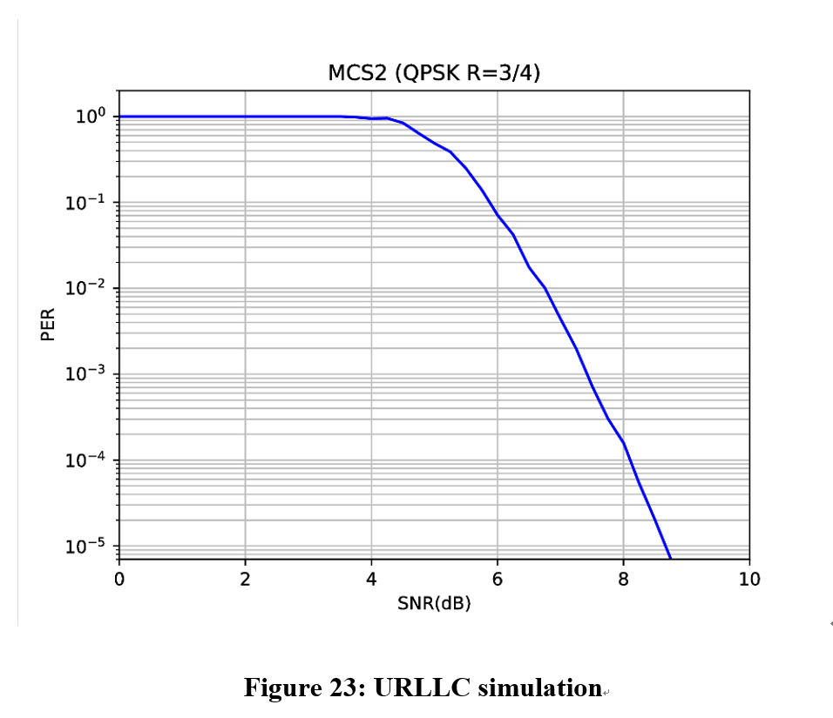
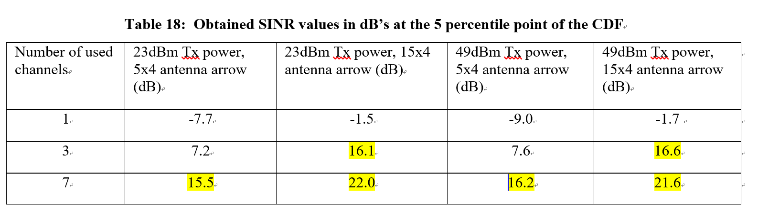
0ms interruption time （1/2）
Related KPI
Peak data rate
Peak spectrum efficiency
User experience data rate
5th percentile user spectral efficiency
Average spectral efficiency
Area traffic capacity
Latency
Connection density
Energy efficiency
Reliability
Mobility
Mobility interruption time
Bandwidth
(from Doc 5D-222 Att. 5.3) No ”0ms interruption time” description in GCS spec.
There is no definition for handover request and other essential signaling, such as exchange user data information format, handover request/response, interface definition between points (base stations).
Furthermore, the self-evaluation report mentions that DECT only can meet the Reliability requirements under the three or seven frequency reuse channels.
However, the 0ms mobility time cannot be implemented when the frequency reuse channels are allocated. Please the next page….

Slide 5
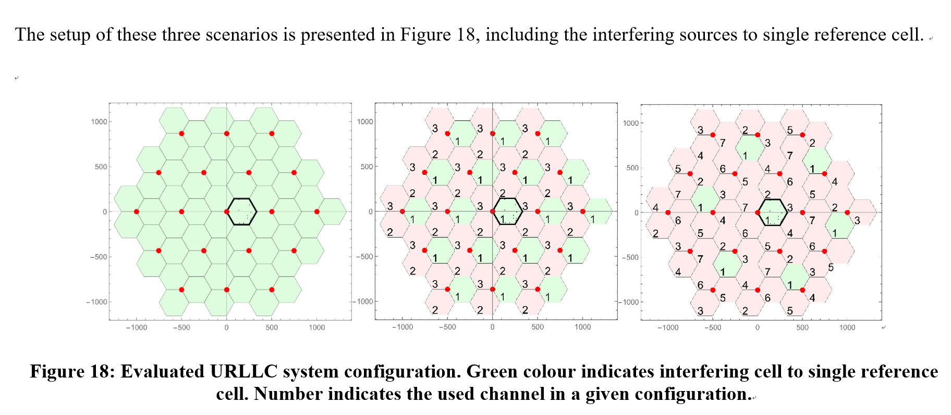
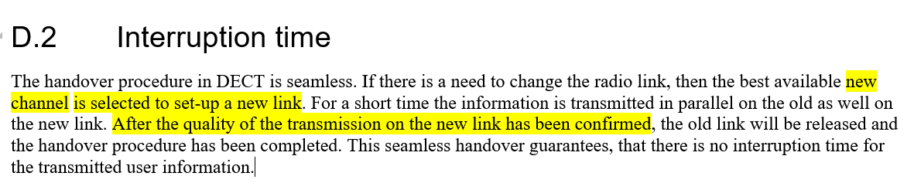
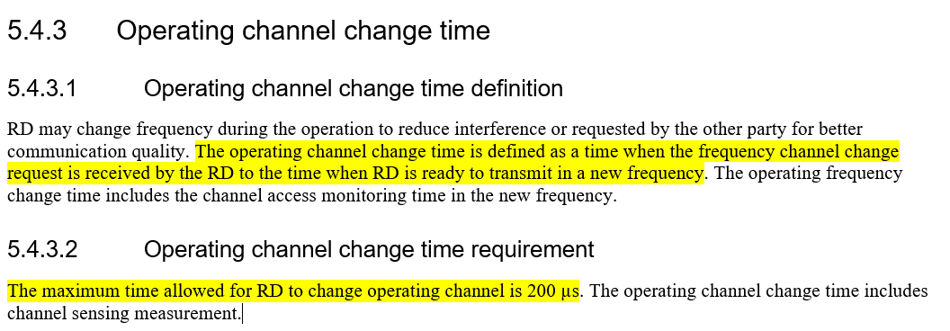
0ms interruption time (2/2)
Step 1
Step 2
Step 3
Step 4
Send request
Received the change request
Ready to transmit
Transmit data
ETSI TS 103 636-2 V1.1.1 (GCS)
Annex D – Additional Information on ‘Mobility interruption time’
from Doc 5D-222 Att. 5.3
UE moves from channel 1 cell to the channel 2 cell, but the spec define the operating change time to switch channel , which is not 0ms.

Slide 6
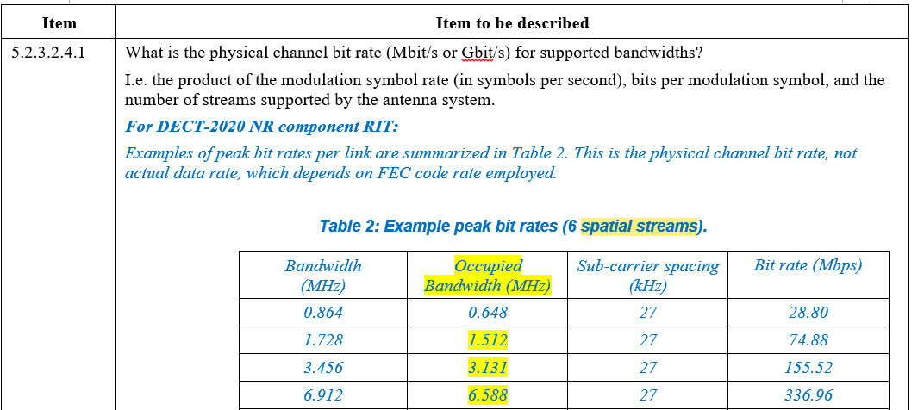
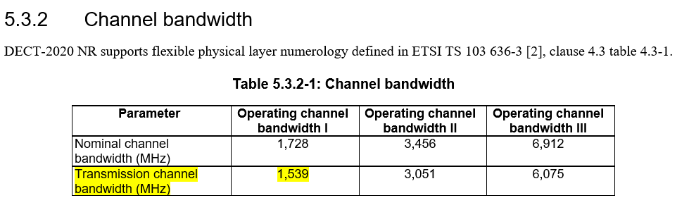
DECT GCS is different from Step 3 technology submission (1/2)
Occupied Bandwidth
(from Doc 5D-222 Att. 5.3). “Occupied Bandwidth is described in 5.2.3 Description template ”
The evaluation is based on the Step 3 submission.
The occupied bandwidth is changed compared with Step 3 submission. Note: 1.728 channel bandwidth is used to mMTC and URLLC evaluation.
ETSI TS 103 636-2 V1.1.3

Slide 7
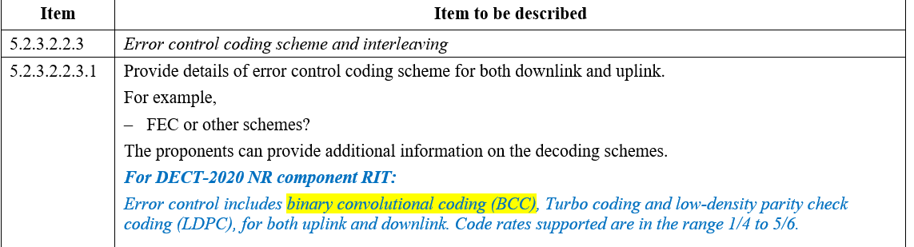
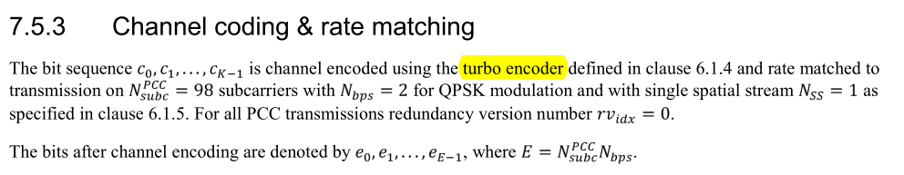
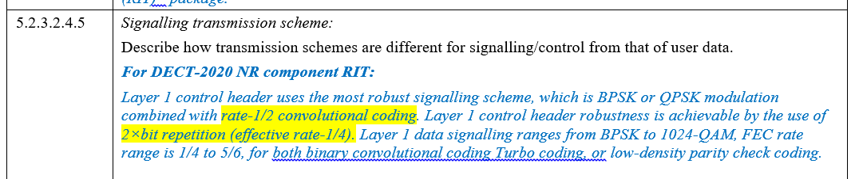
DECT GCS is different from Step 3 technology submission (2/2)
L1 control information
(from Doc 5D-222 Att. 5.3). “Layer 1 control is described in 5.2.3 Description template .”
The channel coding of control information is changed from CC in Step 3 submission to Turbo. Besides, the 2 x bit repetition is not described in the spec.
ETSI TS 103 636-3 V1.1.1(GCS)

Slide 8
Scheduling method impact (1/2)
PF is used in the previous evaluation, and DECT comments this classic PF scheduling method
Firstly, the same PF scheduling is used in 3GPP evaluation.
Secondly, perhaps DECT prefers equally schedule chances for each user. So, we provide the round robin scheduling in next page
IMT-2020/38 DECT comments
In system level simulation assumptions (Table 4-1 in Annex 3 of [ChEG] and Table A-1 of [5GIA]), the scheduling is based on PF, Proportionally Fair scheduling. It is not apparent how scheduling will impact the performance results as the system level simulations should be based on full buffer use for collecting SINR statistics, and not to optimize system throughput at this stage. Proportional fair scheduling could favor those users in the good condition over the users in more challenging conditions and therefore may skew reliability results. As in these simulations each connection should always have data for transmission (based on full buffer) and systematic scheduling bias for good users may impact to SINR statistics collection.

Slide 9
Scheduling method impact (2/2)
The definition of scheduling method
Classic PF scheduling method : PF factor is related with current data rate and historical data rate.
Classic RR scheduling method: Each cell schedules the UEs one by one, but the scheduling order is randomly generated.
Table 1 5%-tile SINR obtained from system-level simulation (Initial)
Configuration | Scheduling | Wrap around | Case 1 (Frequency reuse 1) | Case 2 (Frequency reuse 3) | Case 3 (Frequency reuse 7)
BS Tx power: 49 dBm BS antenna array: 15x4 | PF | Yes | -2.8 | 4.4 | 6.9
 | RR | Yes | -2.8 | 4.3 | 7.2
Conclusion: the SINR values are no obviously different between the two methods.

Slide 10
Thank you

