Slide 1
Analysis on TSDSI submission

Slide 2
Outline:
Performance analysis of TSDSI submission
  TSDSI Pi/2 BPSK
  TSDSI Fast SRS precoding
  TSDSI BWP configurations
  TSDSI Adaptive PTRS density
Implementation impact of TSDSI submission

Slide 3
Performance analysis of TSDSI Pi/2 BPSK

Slide 4
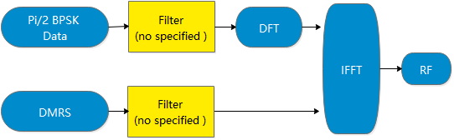
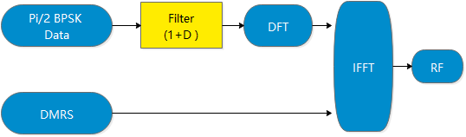
Performance analysis of TSDSI Pi/2 BPSK (background-PHY)
TSDSI Pi/2 BPSK means:
Mandatory with adding one Filter in Pi/2 PUSCH/PUCCH process and without any Filter in DMRS process.
3GPP 38.211 v16.1.0
TSDSI T3.9038.211-15.5.0 V1.0.0
3GPP
Pi/BPSK
TSDSI
Pi/BPSK
TSDSI adds the yellow high light wording;
Transform precoding shall be applied according to

Slide 5
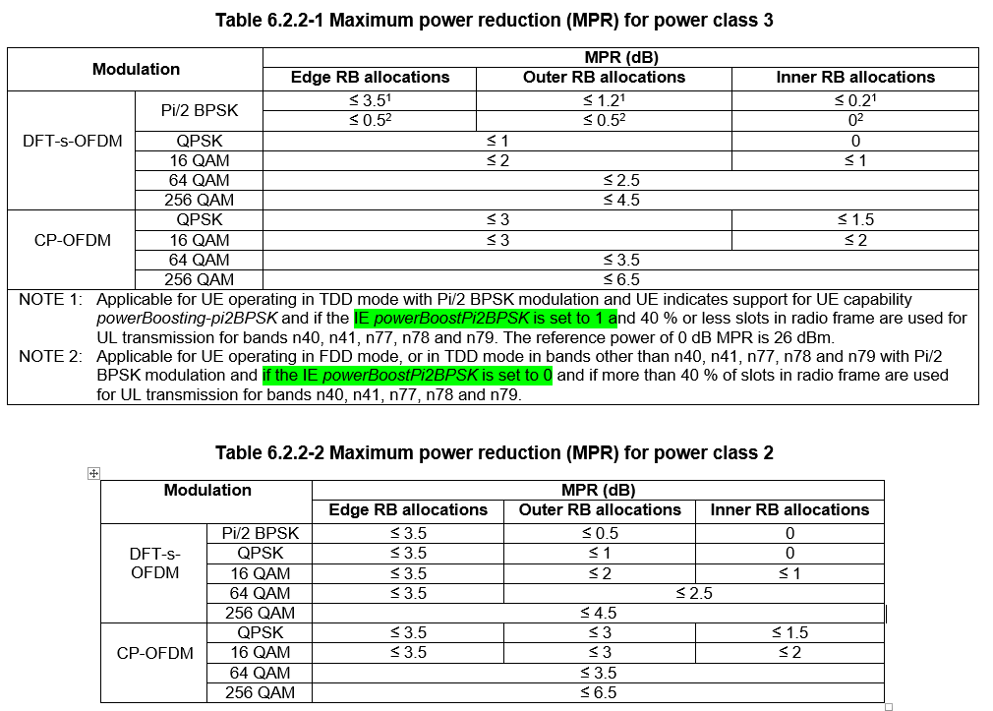
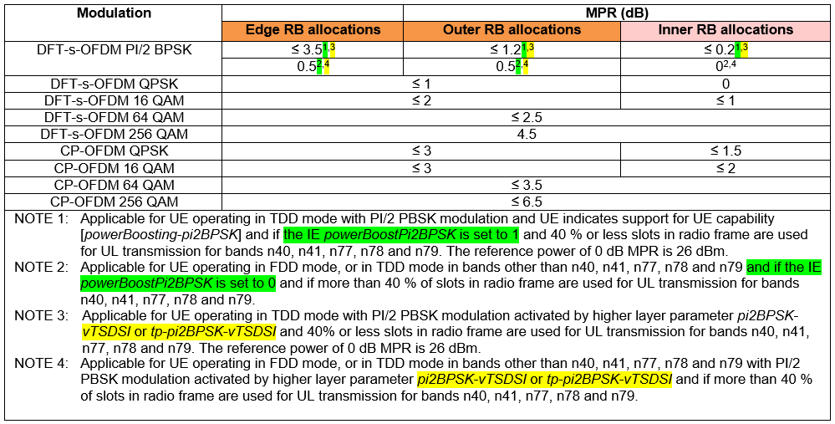
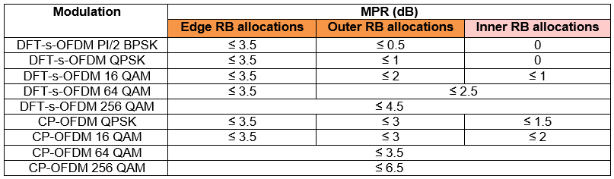
Performance analysis of TSDSI Pi/2 BPSK (background-RF)
According to the specification of 3GPP and TSDSI.
Observation 1: The specification about power reduction of TSDSI Pi/2 BPSK is the same with 3GPP Pi/2 BPSK .
Observation 2: The specification when TSDSI enable/disable is the same with 3GPP IE powerBoostPiBPSK = 1/0.
3GPP 38.101-1 v16.1.0
TSDSI T3.9038.101-1-15.5.0 V1.0.0
Table 6.2.2-1 Maximum power reduction (MPR) for power class 3
Only add TSDSI IE and any value is not changed
Table 6.2.2-2 Maximum power reduction (MPR) for power class 2

Slide 6
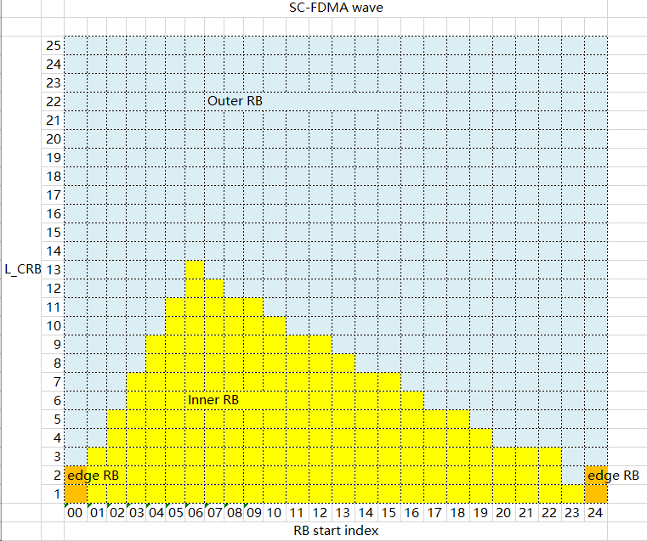
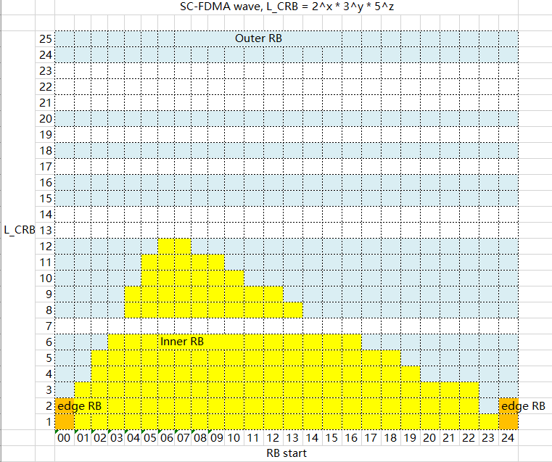
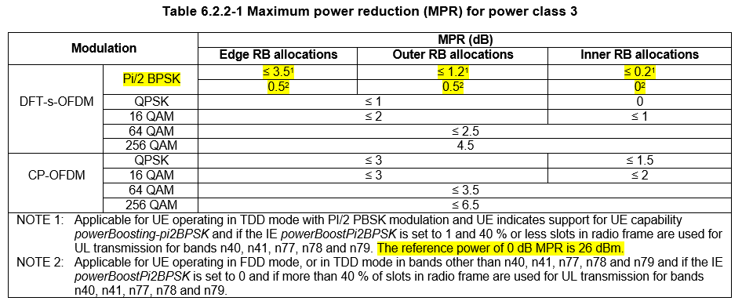
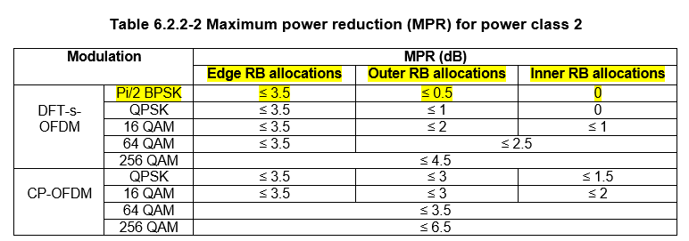
Performance analysis of TSDSI Pi/2 BPSK (benefit analysis)
TSDSI claims the TSDSI Pi/2 BPSK can provide 3dB gain than without it. However, the following consideration:
Consideration 1：Even if TSDSI Pi/2 BPSK can achieve the gain from PAPR or EVM, the gain cannot make the UE transmit power exceed the maximum value [23dBm or 26dBm depends on power class].
Consideration 2：The transmission power is limited for cell edge UEs, thus cell edge UE should not be allocated with many PRBs. Network can scheduling cell edge UEs in inner RB, in which UE has less than 0.2dB power reduction. According to3GPP specification, the maximum power reduction for inner RB allocation is less than 0.2dB for PC3 and 0dB for PC2. In this case, any specific filtering should not have more than 0.2dB gain.
SC-FDMA wave in 5M bandwidth
CP-OFDM wave in 5M bandwidth
3GPP 38.101-1 v16.1.0
Link budget result
700MHz FDD (NLOS O-to-I) PUSCH | cell radius | coverage area
baseline | 1448 m | 6,959,752 m²
0.2dB improvement | 1506 m (gain: 4.0%) | 7,127,669m² (gain: 2.41%)
Conclusion: Compared with 3GPP Pi/BPSK, TSDSI Pi/BPSK has no more than 0.2dB transmit power improvement when the UE is scheduled in inner RBs.

Slide 7
Performance analysis of TSDSI Fast SRS precoding

Slide 8
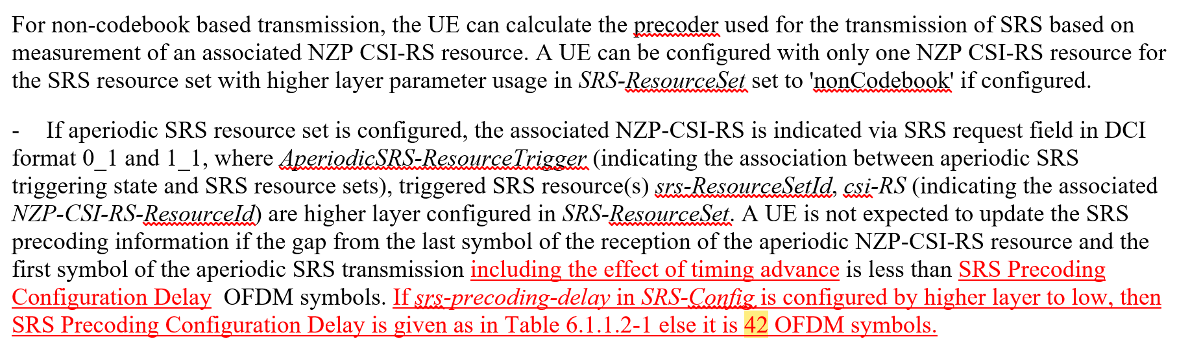
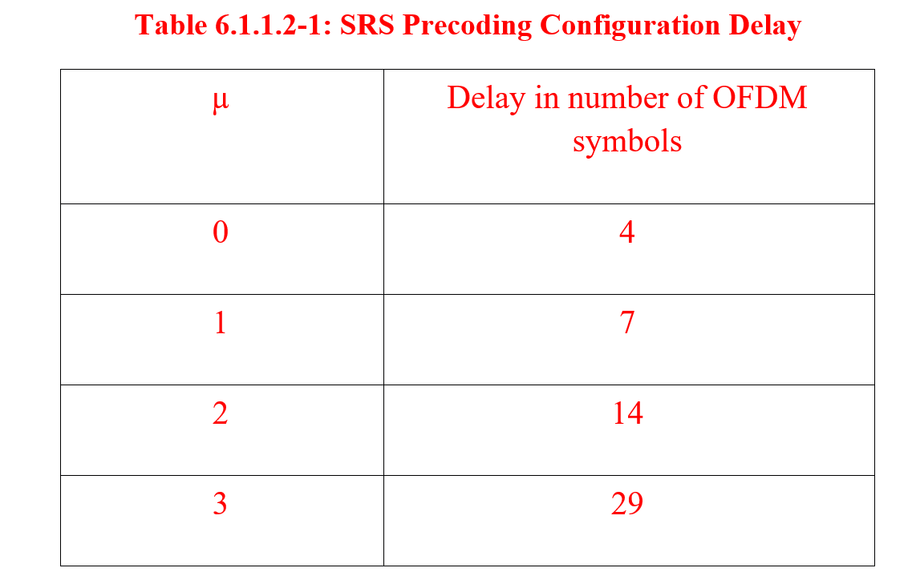
Performance analysis of TSDSI Fast SRS precoding (background-PHY)
TSDSI Fast SRS precoding means:
Reduce time gap from 42 OFDM symbol in 3GPP -> 4(15KHz SCS), 7(30KHz SCS), 14(60KHz SCS), 29(120KHz SCS).
TSDSI T3.9038.214-15.5.0 V1.0.0
3GPP 38.214 v15.7.0
For non-codebook based transmission, the UE can calculate the precoder used for the transmission of SRS based on measurement of an associated NZP CSI-RS resource. A UE can be configured with only one NZP CSI-RS resource for the SRS resource set with higher layer parameter usage in SRS-ResourceSet set to 'nonCodebook' if configured.
- If aperiodic SRS resource set is configured, the associated NZP-CSI-RS is indicated via SRS request field in DCI format 0_1 and 1_1, where AperiodicSRS-ResourceTrigger and AperiodicSRS-ResourceTriggerList (indicating the association between aperiodic SRS triggering state(s) and SRS resource sets), triggered SRS resource(s) srs-ResourceSetId, csi-RS (indicating the associated NZP-CSI-RS-ResourceId) are higher layer configured in SRS-ResourceSet. A UE is not expected to update the SRS precoding information if the gap from the last symbol of the reception of the aperiodic NZP-CSI-RS resource and the first symbol of the aperiodic SRS transmission is less than 42 OFDM symbols.

Slide 9
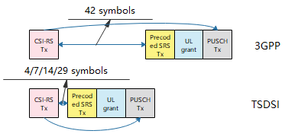
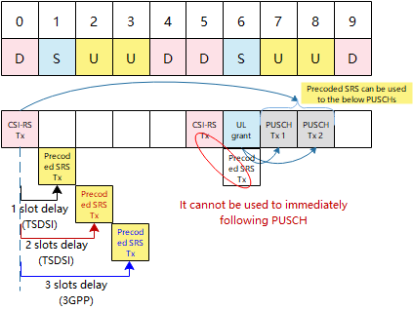
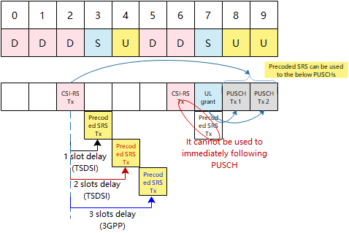
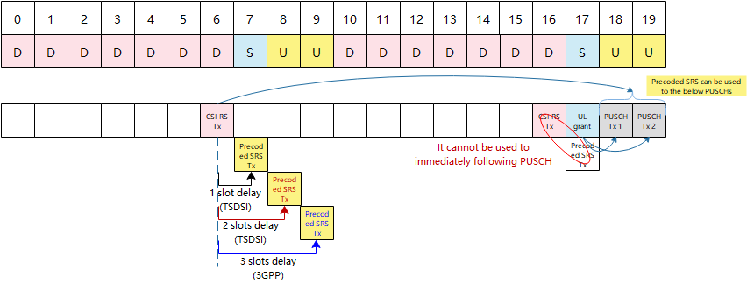
Performance analysis of TSDSI Fast SRS precoding (benefit analysis 1)
Ideal [CSI-RS to PUSCH] minimum delay reduction
TSDSI predicts gain from fast processing SRS delay.
However, the delay reduction only directly reflects in FDD system. As non-precoding SRS is used in TDD system, the delay should consider the factual UL/DL configuration.
Cofig0: DSUUD DSUUD
Cofig1: DDDSU DDSUU
Cofig2: DDDDD DDSUU
No factual [CSI-RS to PUSCH] minimum delay reduction

Slide 10
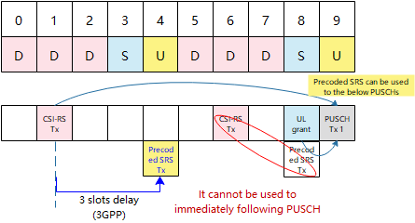
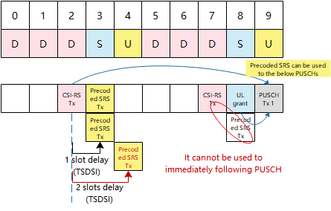
Performance analysis of TSDSI Fast SRS precoding (benefit analysis 2)
3GPP 38.214 v15.7.0
TSDSI T3.9038.214-15.5.0 V1.0.0
Cofig3: DDDSU DDDSU
TSDSI has one slot latency reduction than 3GPP
7 slots [CSI-RS to PUSCH] delay
6 slots [CSI-RS to PUSCH] delay
Simulation Configuration | UE speed | Delay of CSI to SRS | Avg. spectrum efficiency [bps/Hz/TRxP] | 5% spectrum efficiency [bps/Hz]
Dense Urban 2T32R CF = 4 GHz ISD = 200m BW = 20 MHz SCS = 30KHz Frame structure = DDDSU | 30km/h | 1 slot/2 slots (TSDSI) | 7.038 (0%, baseline) | 0.420 (0%, baseline)
 | 30km/h | 3 slot (3GPP) | 7.036 (0.0%) | 0.418 (-0.6%)
 | 60km/h | 1 slot/2 slots (TSDSI) | 6.984 (0%, baseline) | 0.419 (0%, baseline)
 | 60km/h | 3 slot (3GPP) | 6.983 (0.0%) | 0.415 (-1.1%)
Conclusion: In most cases [ TDD Cofig0/1/2], TSDSI fast SRS precoding has NO delay reduction. In a few cases [TDD Cofig3], the delay reduction has no more than 1.1% gain for edge SE and no impact on average SE.

Slide 11
Performance analysis of TSDSI BWP configurations

Slide 12
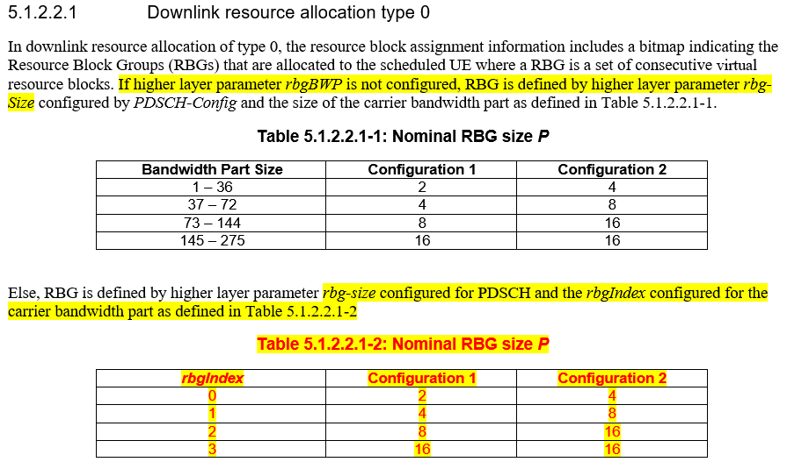
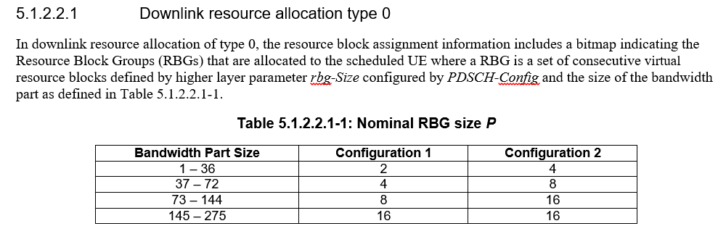
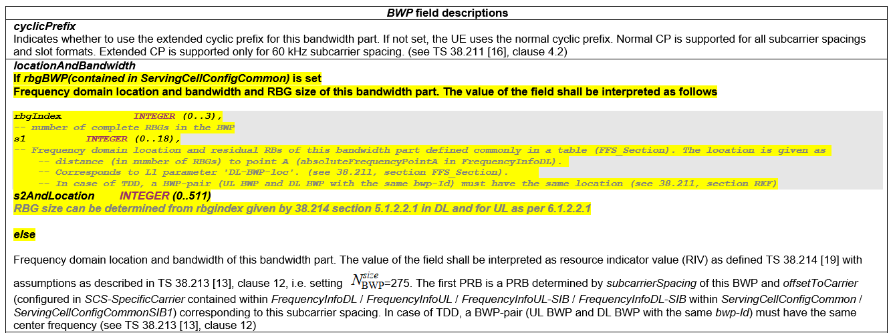
Performance analysis of TSDSI BWP configurations (background-PHY/RRC)
TSDSI BWP configurations means:
Add TSDSI RBG size and Define TSDSI BWP RRC Indication.
3GPP 38.214 v15.7.0
TSDSI T3.9038.214-15.5.0 V1.0.0
3GPP 38.331 v15.7.0
BWP field descriptions
cyclicPrefix Indicates whether to use the extended cyclic prefix for this bandwidth part. If not set, the UE uses the normal cyclic prefix. Normal CP is supported for all subcarrier spacings and slot formats. Extended CP is supported only for 60 kHz subcarrier spacing. (see TS 38.211 [16], clause 4.2)
locationAndBandwidth Frequency domain location and bandwidth of this bandwidth part. The value of the field shall be interpreted as resource indicator value (RIV) as defined TS 38.214 [19] with assumptions as described in TS 38.213 [13], clause 12, i.e. setting =275. The first PRB is a PRB determined by subcarrierSpacing of this BWP and offsetToCarrier (configured in SCS-SpecificCarrier contained within FrequencyInfoDL / FrequencyInfoUL / FrequencyInfoUL-SIB / FrequencyInfoDL-SIB within ServingCellConfigCommon / ServingCellConfigCommonSIB) corresponding to this subcarrier spacing. In case of TDD, a BWP-pair (UL BWP and DL BWP with the same bwp-Id) must have the same center frequency (see TS 38.213 [13], clause 12)

Slide 13
Performance analysis of TSDSI BWP configurations (benefit analysis -RBG )
TSDSI BWP configurations use larger RBG size to reduce DCI size .
Observation 1：DCI payload reduction percentage is always below 10%.
BWP size (# of PRBs) |  | Frequency domain resource assignment bit based on BWP | DCI Other payload plus CRC | DCI Payload reduction percentage 3GPP vs TSDSI
73-275 | 3GPP | Same bit number since 3GPP and TSDSI support at most RBG = 16. | DCI payload without frequency allocation plus CRC 28 + 24 (fallback DCI) 70 + 24( non-fallback DCI) | 0%
 | TSDSI
37-72, e.g. 72 | 3GPP | 9 = (72/8) |  | fallback DCI: (9-5)/(28+24+9)~6.6% Non-fallback DCI: (9-5)/(70+24+9)~3.8%
 | TSDSI | 5= (72/16)
1-36, e.g. 36 | 3GPP | 9 = (36/4) |  | fallback DCI: (9-3)/(28+24+9)~9.8% Non-fallback DCI: (9-3)/(70+24+9)~5.8%
 | TSDSI | 3= (36/16)
Observation 2：The spectrum efficiency has up to 15.6% loss since TSDSI Large RBG scheduling granularity leads to resource waste.
Simulation Configuration |  | RB# per RBG | Avg. spectrum efficiency [bps/Hz/TRxP] | 95% spectrum efficiency [bps/Hz] | 5% spectrum efficiency [bps/Hz]
Dense Urban 32T4R CF = 4 GHz ISD = 200m SCS = 30KHz | BWP size=51 RB | 8 (3GPP) | 11.90 (baseline) | 2.603 (baseline) | 0.351 (baseline)
 |  | 16 (TSDSI) | 11.15 (-6.3%) | 2.402 (-7.7%) | 0.337 (-4.0%)
 | BWP size=16 RB | 4 (3GPP) | 11.89 (baseline) | 2.573 (baseline) | 0.351 (baseline)
 |  | 16 (TSDSI) | 10.317 (-13.3%) | 2.172 (-15.6%) | 0.35 (-0.1%)
Conclusion: TSDSI DCI payload reduction is always below 10%, while TSDSI larger RBG approach brings UP TO 15.6% SE loss.

Slide 14
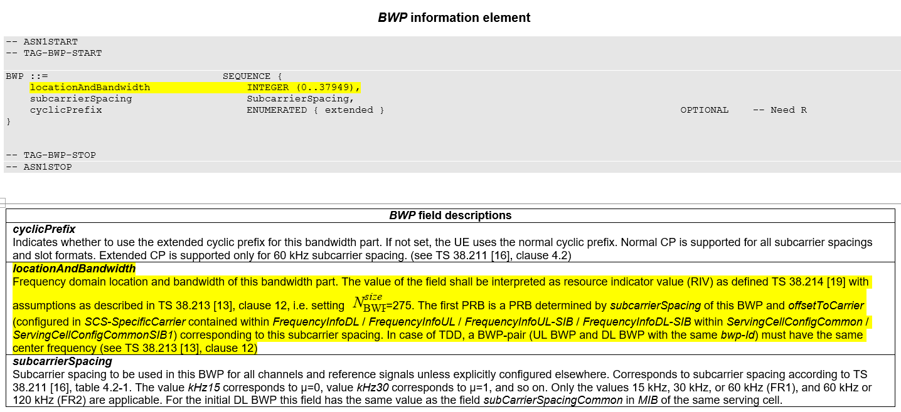
Performance analysis of TSDSI BWP configurations (benefit analysis -BWP)
TSDSI BWP configurations use TSDSI RRC signaling to configure BWP.
Observation 1：BWP size could be flexibly configured at per PRB granularity by 3GPP specification 38.331 and 38.213.
Observation 2：Resource wastage can be avoided by properly configuring the BWP size for different UEs and also by using appropriate frequency domain resource allocation type, based on 3GPP specification 38.214.
3GPP 38.213 v15.7.0
3GPP 38.331 v15.7.0
3GPP 38.214 v15.7.0
Conclusion: 3GPP specification already can implement no resource wastage and flexible configured BWP size, without TSDSI BWP configurations .

Slide 15
Performance analysis of TSDSI Adaptive PTRS density

Slide 16
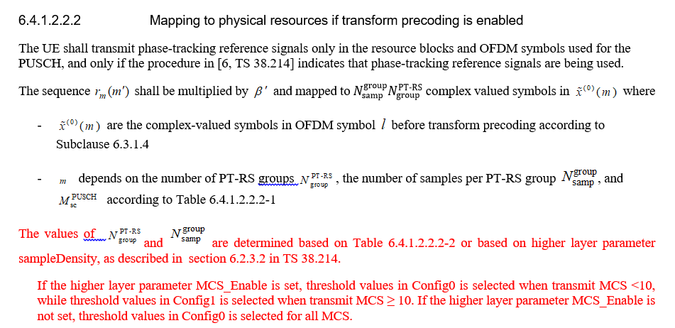
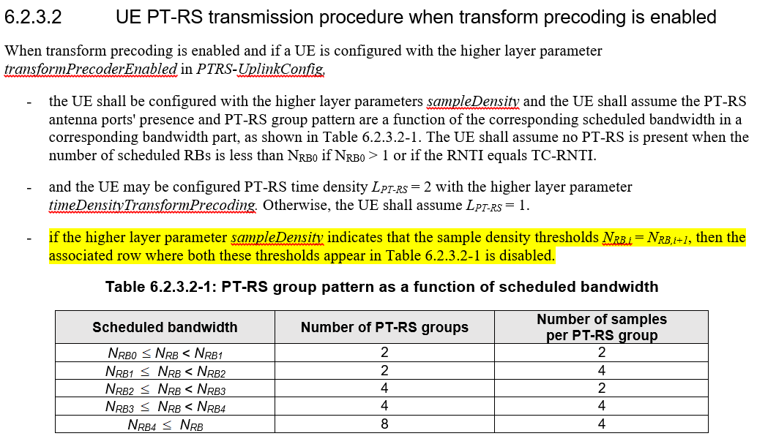
Performance analysis of TSDSI Adaptive PTRS density (background)
TSDSI T3.9038.211-15.5.0 V1.0.0
TSDSI adaptive PTRS density do the following modification based on 3GPP specifications:
Default values for NRBi, i = 0,1,…4 to reduce RRC signaling overhead
SINR based selection of chunk size to reduce PTRS overhead
  Choose chunks with size 2 (K=2) for high SINR
3GPP 38.214 v15.7.0
Table 6.4.1.2.2.2-2: Threshold values of scheduled BW (NRBi, i=0,1,2,3,4,5)
Config0 | Config1
N_{RB0} = 0 | N_{RB0} = 0
N_{RB1} = 8 | N_{RB1} = N_{RB2} = 24
N_{RB2} = N_{RB3} = 24 | N_{RB3} = N_{RB4} = 96
N_{RB4} = 96
TSDSI T3.9038.214-15.5.0 V1.0.0
When transform precoding is enabled and if a UE is configured with the higher layer parameter phaseTrackingRS-TransformPrecoding in DMRS-UplinkConfig
- if the higher layer parameter sampleDensityPresent is not set, the UE shall assume that the threshold values of scheduled bandwidth, i.e., (N_{RBi}, i=0,1,..4) are based on Table 6.4.1.2.2.2-2 in [1, TS 38.211] and the UE shall assume the PT-RS antenna ports' presence and PT-RS group pattern are a function of the corresponding scheduled bandwidth in a corresponding bandwidth part, as shown in Table 6.2.3.2-1.
- if the higher layer parameter MCS_Enable is set, then UE shall assume N_{RB2} = N_{RB1} and N_{RB4} = N_{RB3} and the associated row where both these thresholds appear in Table 6.2.3.2-1 is disabled.
- if the higher layer parameter differentialThreshold is set, then UE shall assume that NRB₁ = sampleDensity(1) and NRB_{i} = NRB_{(i-1)} + sampleDensity (i), i = 2,..,4.

Slide 17
Performance analysis of TSDSI Adaptive PTRS density (benefit analysis)
PTRS that mainly is for phase noise, is not critical for FR1. The phas noise was raised in 3GPP RAN1 based on R1-165685.
Analysis for TSDSI Adaptive PTRS density.
  Default values of N_{RBi} provide RRC Signaling reduction by losing flexibility and forward compatibility. Besides, RRC overhead is not critical.
  TSDSI PTRS density not only decreases overhead in some cases but also increases overhead in other cases. TSDSI PTRS density increases up to 1.3% PTRS overhead during 24-96 RB, and only at most 2% overhead reduction during 8-24 RB.
3GPP 38.331 v15.7.0
PTRS-DensityRecommendationUL ::= SEQUENCE {
frequencyDensity1 INTEGER (1..276),
frequencyDensity2 INTEGER (1..276),
timeDensity1 INTEGER (0..29),
timeDensity2 INTEGER (0..29),
timeDensity3 INTEGER (0..29),
sampleDensity1 INTEGER (1..276),
sampleDensity2 INTEGER (1..276),
sampleDensity3 INTEGER (1..276),
sampleDensity4 INTEGER (1..276),
sampleDensity5 INTEGER (1..276)
}
Assuming one PTRS configured symbol per 2 symbols
Scheduled bandwidth | One configuration supported by 3GPP (N_{RB0} =0; N_{RB1} =8; N_{RB2} =24; N_{RB3} =N_{RB4} =96 ) | TSDSI Cofig 0 (N_{RB0} =0; N_{RB1} =8; N_{RB2} =N_{RB3}=24; N_{RB4} =96 ) | TSDSI Cofig 1 (N_{RB0} =0; N_{RB1} =N_{RB2} =24; N_{RB3}=N_{RB4} =96 )
0 <= N_{RB} < 8 | 2*2 (baseline) | 2*2 (0%) | 2*2 (0%)
8 <= N_{RB} < 24 | 2*4 (baseline) | 2*4 (0%) | 2*2 (0.70% to 2.08% PTRS overhead reduction)
24<= N_{RB} < 96 | 4*2 (baseline) | 4*4 (Increase 0.35% to 1.39% PTRS overhead) | 4*2 (0%)
96 < N_{RB} | 8*4 (baseline) | 8*4 (0%) | 8*4 (0%)

Slide 19
Evaluation assumption for TSDSI impact at Page 10 and Page 13

Slide 20
Evaluation assumption for downlink spectral efficiency (1/2)
Parameters | Values
Test environment | Dense Urban – eMBB
Evaluation configuration | Configuration A
Channel model | UMa_B
ISD | 200 m
TDD frame structure | DDDSU
Carrier Frequency | 4GHz
System bandwidth | TDD: 20MHz, 6.4MHz
Subcarrier spacing | 30 kHz
Symbols number per slot | 14
Number of antenna elements per TRxP | For 32Tx: 128Tx cross-polarized antennas (M,N,P,Mg,Ng) = (8,8,2,1,1)
Number of TXRU per TRxP | 32TXRU: Vertical 1-to-4
Number of antenna elements per UE | 4Rx with 0°and 90° polarization
Transmit power per TRxP | 44 dBm
TRxP number per site | 3
Mechanic tilt | 90deg in GCS (pointing to the horizontal direction)
Electronic tilt | 105deg in LCS
UT attachment | Based on RSRP (Eq. (8.1-1) in TR 36.873) from port 0

Slide 21
Evaluation assumption for downlink spectral efficiency (2/2)
Parameters | Values
Test environment | Dense Urban – eMBB
Scheduling | MU-PF
ACK/NACK delay | Next available UL slot
MIMO mode | MU-MIMO with rank 2/4 adaptation per user; Maximum MU layer = 12
Guard band ratio | 8.2% for 30kHz SCS and 20MHz 10% for 30kHz SCS and 6.4MHz
BS receiver type | MMSE-IRC
CSI feedback | 5 slots period based on precoded CSI-RS
Traffic model | Full buffer
SRS transmission | Non-precoded SRS for 4Tx ports; Period: 5 slots; 2 symbols for 30kHz SCS;
Precoder derivation | TDD: SRS based
Channel estimation | Non-ideal
Waveform | OFDM

